Slide 1
Underwater acoustic sensor networks: research challenges

Slide 2
Applications of acoustic sensor networks
Applications:
Ocean sampling networks.
Environmental monitoring.
Undersea explorations.
Disaster prevention.
Assisted navigation.
Distributed tactical surveillance.
Mine reconnaissance.

Slide 3
Disadvantages of traditional communication systems.
No real-time monitoring.
No on-line system reconfiguration.
No failure detection.
Limited storage capacity.

Slide 4
Challenges in design of underwater acoustic networks
Limited Bandwidth
Multipath and Fading
Slow propagation speed
High bit error rate
Limited battery power
Prone to failures due to corrosion.

Slide 5
UW - ASNs: Communication Architecture
Static Two DImensional UW-ASNs:
Sensor nodes anchored to bottom of the ocean
Typical applications include environmental monitoring, monitoring of underwater plates in tectonics
Static Three Dimensional UW-ASNs:
Consist of sensors whose depth can be controlled
Used for surveillance applications or monitoring ocean phenomena
Three Dimensional Networks of Autonomous Underwater Vehicles:
Compose of anchored sensors and mobile portions constituted by autonomous vehicles

Slide 6
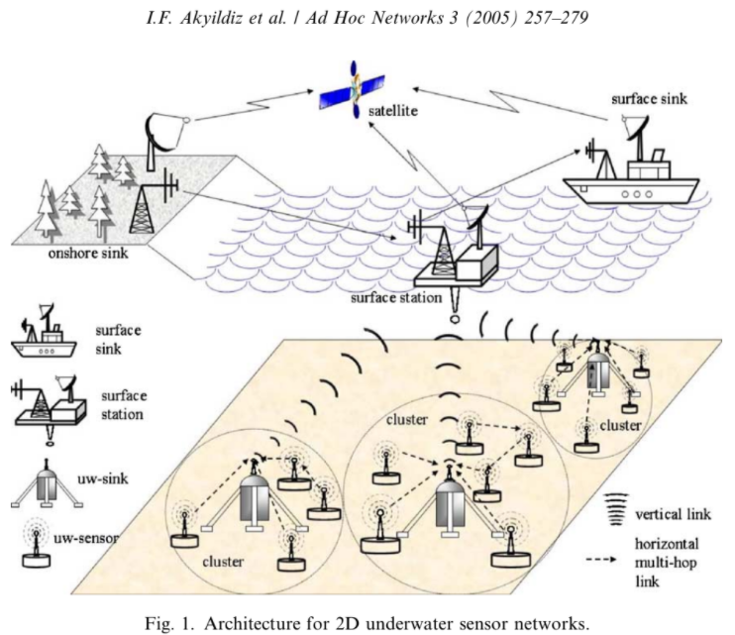

Slide 7
How can sensors connect to UW Sinks?
Direct: Sensor directly sends gathered data to selected UW Sink
Large amounts of power required for longer distances
Lower throughput due to increased acoustic interference
Multi - Hop: Data produced by source sensor is relayed by intermediate sensors until it reaches UW sink
Increased network capacity and energy savings but also increased complexity
Each network device involved in collaborative process which requires more signaling and computation

Slide 8
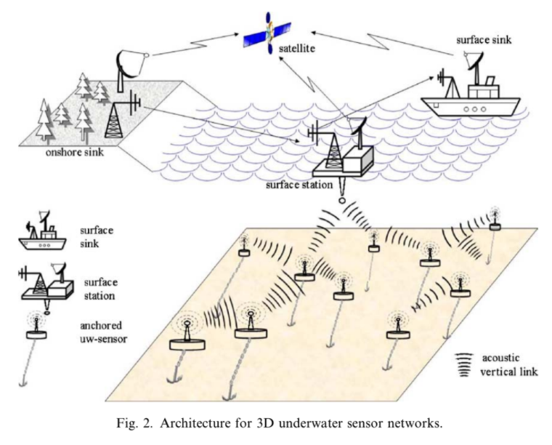

Slide 9
Challenges in 3D Monitoring
Sensing Coverage:
Sensors should collaboratively regulate their depth in order to achieve 3D coverage of the ocean column, according to their sensing ranges
It must be possible to obtain sampling of the desired phenomenon at all depths.
Communication Coverage:
There may be no notion of uw-sink, sensors should be able to relay information to the surface station via multi-hop paths
Network devices should coordinate their depths in such a way that the network topology is always connected, i.e. at least one path from every sensor to the surface station always exists.

Slide 10
Sensor Networks with AUVs
Freedom from cables, tethers or remote controls - leading to a multitude of applications
AUVs is an almost unexplored research area and hence requires new network coordination algorithms such as -
Adaptive Sampling
Self-Configuration
We aim to minimize dependency on communications from shores
Solar Energy Systems increase lifetime of AUVs
Types of AUVs -
Small Scale Submarines
Drifters
Gliders

Slide 11
Design challenges
Major differences in terrestrial and underwater sensor networks:
Cost
Deployment
Power
Memory
Spatial correlation

Slide 12
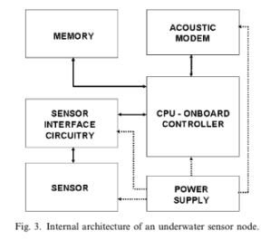
Underwater Sensor
UW Sensors are used to study :
Temperature, density, salinity, acidity, chemicals, conductivity, pH, oxygen, hydrogen, dissolved methane gas, and turbidity.
Natural microbial populations
Concentrations of different chemicals.
Pyramidical design

Slide 13
Requirements
Development of nano-sensors (1-500 nm)
Device periodical cleaning mechanisms to prevent from rusting and fouling
Robust and stable sensors
Integrated sensors for synoptic sampling

Slide 14
Cross layer protocol stack
Purpose: Combine power awareness and management and promote cooperation among the sensor nodes.
Key functionalities: of physical layer, data link layer, network layer, transport layer, and application layer
3 Main functionalities: Power management plane, Coordination plane, Localization plane.

Slide 15
Advantages
From modem design to MAC and routing
From channel coding and modulation to source compression and transport layer,
Traditional layered approach lacks of information sharing across protocol layers

Slide 16
Limitations
We need to increase battery lifetime and minimize power consumption.
The battery life depends on the following 4 factors:
Internode Distance
Transmission Frequency
Frequency of data updates
Number of nodes per cluster

Slide 17
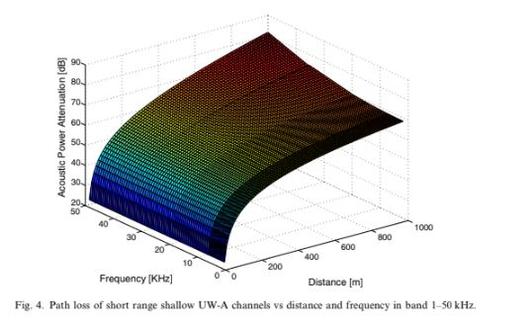

Slide 18
Real Time vs Delay Tolerant Networking
Real Time Networks
Application: Surveillance, Disaster Prevention
Requirements: Limited Delay, Restore connectivity, Dynamic Rerouting
Delay Tolerant networks
Application: Seismic Activities

Slide 19
Basics of acoustic propagation
Underwater acoustic communications are mainly influenced by
Path loss
Noise
Multi-path
Doppler spread
High and variable propagation delay

Slide 20
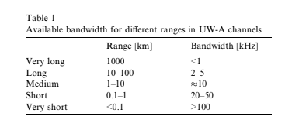
Classifications of Underwater acoustic communication
Range
Vertical & Horizontal

Slide 21
CHALLENGES

Slide 22
Path Loss
Attenuation
Provoked by absorption due to conversion of acoustic energy into heat
Increases with distance and frequency
Geometric Spreading
Spreading of sound energy as a result of the expansion of the wavefronts
Increases with the propagation distance and is independent of frequency.
Two kinds: Spherical (deep water) & Cylindrical (Shallow water)

Slide 23
NOISE
Man made Noise
Machinery noise & shipping activity
Ambient Noise
Hydrodynamics, seismic & biologic activity

Slide 24
Multi-path
Responsible for severe degradation of the acoustic communication signal, since it generates inter-symbol interference (ISI).
Vertical channels are characterized by little time dispersion, whereas horizontal channels may have extremely long multi-path spreads.
Extent of the spreading is a function of depth and the distance between transmitter and receiver.

Slide 25
High delay and delay variance:
Propagation speed in the UW-A channel is five orders of magnitude lower than in the radio channel
Large propagation delay (0.67 s/km) can reduce the throughput of the system considerably
Prevents accurate estimation of Round Trip Time

Slide 26
Doppler Spread
Causes a degradation in the performance of digital communications: high data rate transmissions cause adjacent symbols to interfere at the receiver
Generates a Simple & Continuous Frequency Translation
Continuous has a non shifted signal which is difficult to compensate for
Doppler spread with bandwidth B and a signal has symbol duration T, then there are approximately BT uncorrelated samples
BT<1 : Underspread
BT>1: Overspread

